Slide 1
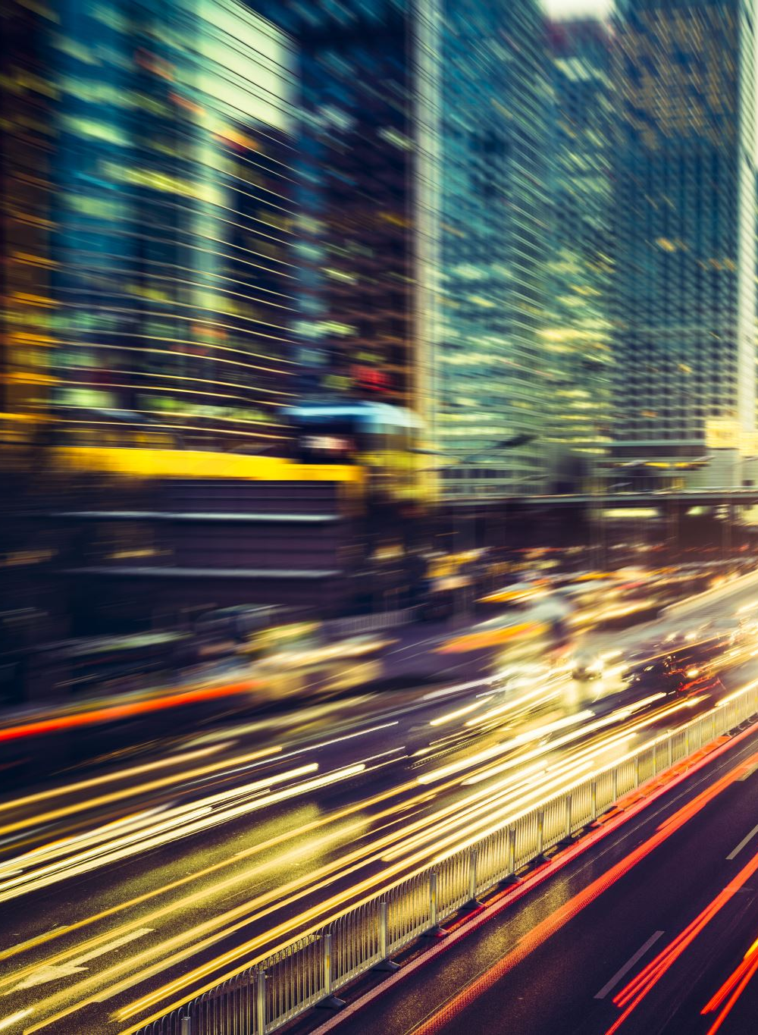

Australian Road Fatalities
Scyne advisory
Data Insights & Recommendations
Noorullah khan

Slide 2
EXECUTIVE SUMMARY
Fatal crashes have declined long-term but plateaued in recent years.
Weekends and late-night hours remain the highest-risk windows.
Young male drivers are disproportionately involved in fatal crashes.
Risks differ across environments: single-vehicle crashes dominate at high speed/night; multi-vehicle crashes peak in commuting hours.
Holiday periods mirror these risks, especially late-night driving, without adding new patterns.

Slide 3




Aim & Hypotheses
Fatal crashes are more likely during weekends and late-night hours
Young male drivers are disproportionately involved in single-vehicle crashes.
High-speed roads see more single-vehicle crashes; multi-vehicle crashes cluster in commuting hours.
Holiday periods amplify existing late-night risks but do not introduce unique new patterns.

Slide 4


Dataset overview

Slide 5
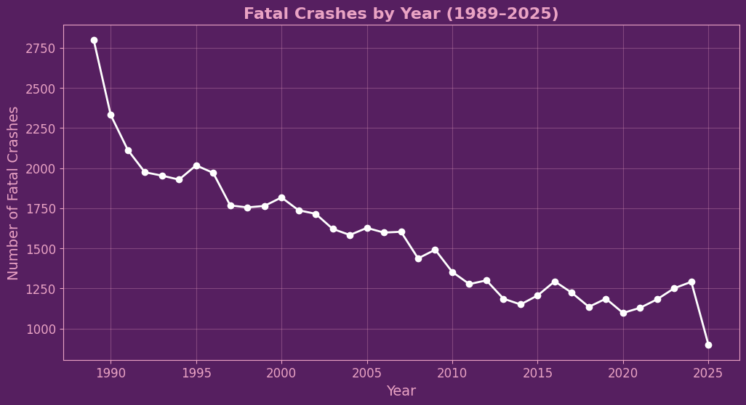
CRASH TRENDS OVER TIME
Fatal crashes declined sharply from late 1980s → mid-2010s.
Decline is remarkable given higher car ownership, more roads, and greater traffic volumes today.
Plateau since ~2020, with slight upward drift.
2025 dip is incomplete year effect (data still incoming).

Slide 6
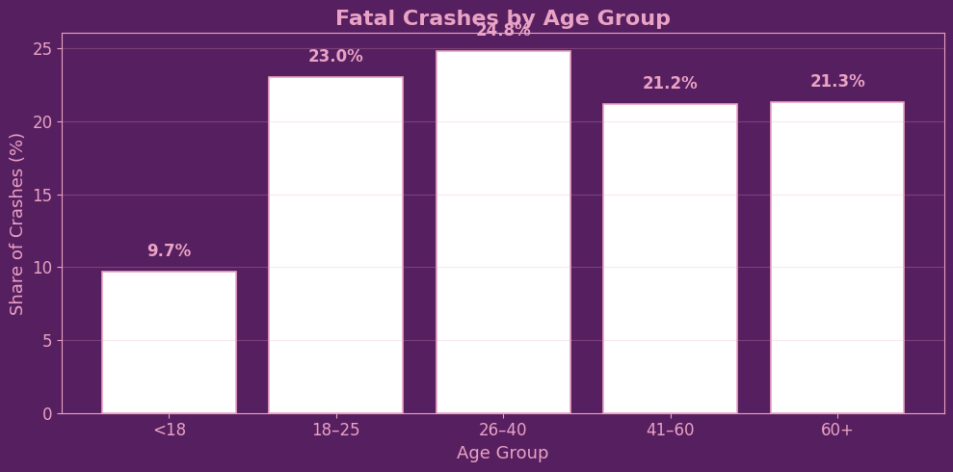
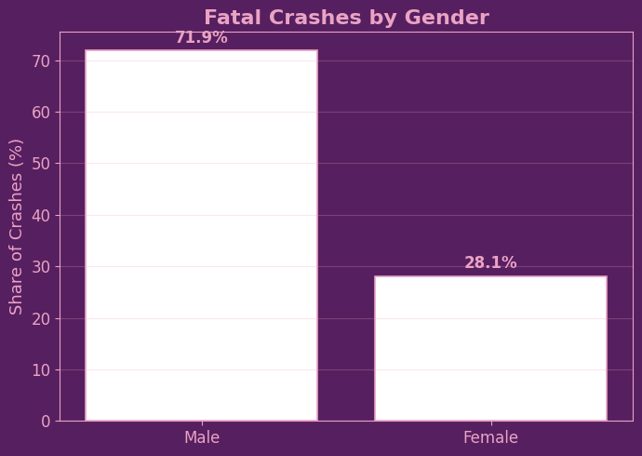
Fatal CRASH Demographics
Young adults (18–25) are heavily overrepresented given their share of the population.
Middle-aged drivers (26–40, 41–60) still contribute significantly, showing crashes aren’t only a “young driver problem.”
Gender imbalance: ~72% of fatal crashes involve male drivers vs ~28% female.
Elderly drivers (60+) show a increase, potentially due to fragility and slower reaction times.

Slide 7
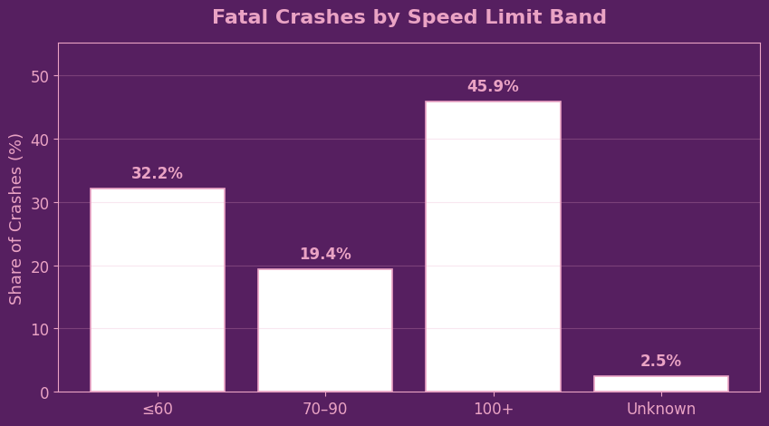
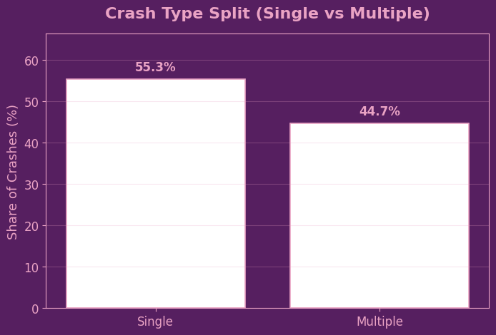
Fatal CRASH Demographics
Almost half of all fatal crashes (46%) occur on high-speed roads (100+).
Urban/commuter zones (≤60 km/h) still account for a large share (~32%), likely due to traffic density.
Single-vehicle crashes dominate (55%) → especially in high-speed or rural contexts.
Multi-vehicle crashes (45%) are still significant, concentrated in commuting/urban settings

Slide 8
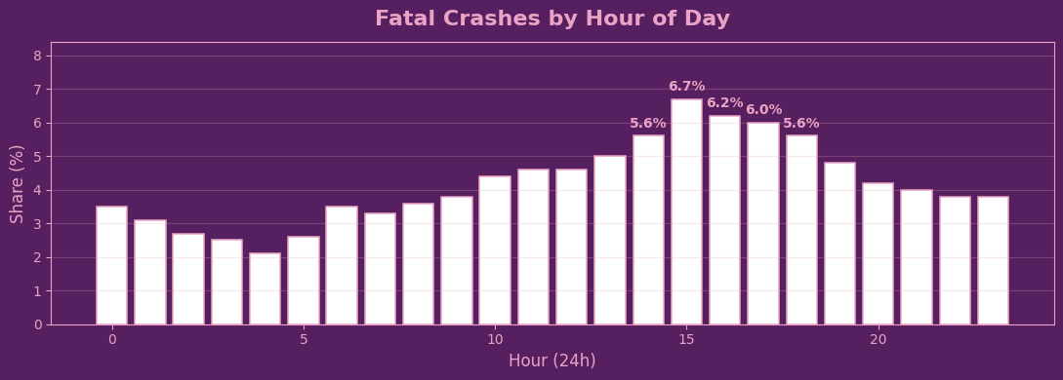
Temporal Patterns

Slide 9
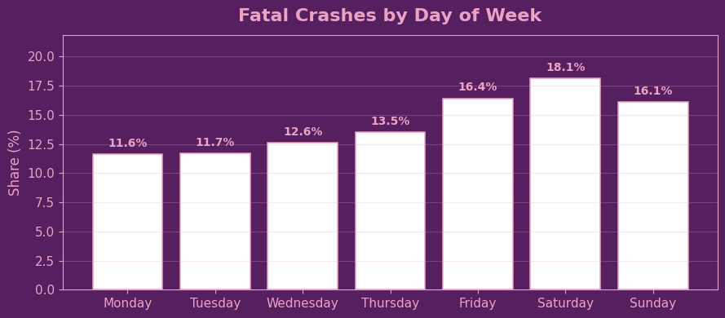
Temporal Patterns

Slide 10
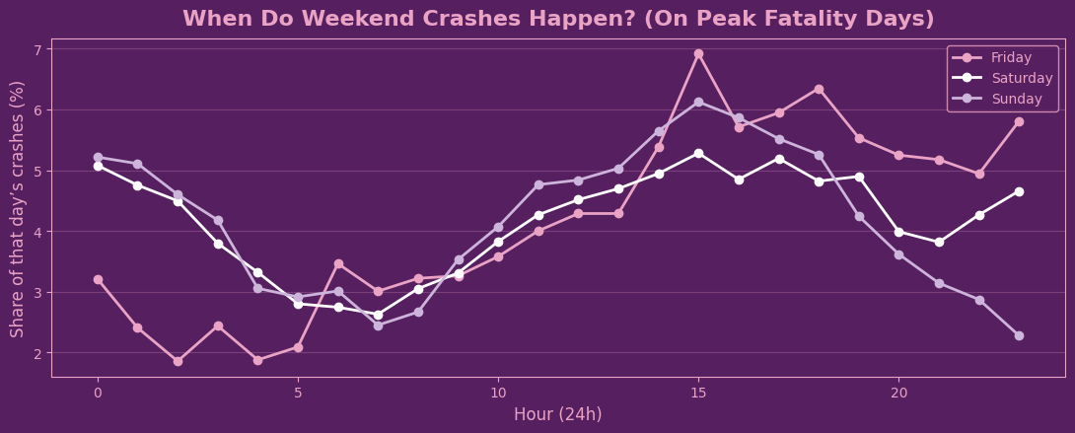
Temporal Patterns

